Slide 1
CONTACT BOOK APPLICATION.
Presented By:
Ramaka Nihal

Slide 2
CONTENTS
Abstract
Problem Statement
Objective
Introduction
System Architecture
Technologies Used
Requirements
Algorithm
Application Workflow
Execution Screenshots
Advantages
Conclusion

Slide 3
ABSTRACT
The Contact Book Application is a command-line based project developed using Python to manage contact information efficiently. It allows users to store contact details such as names and phone numbers in a text file, ensuring that the data is saved permanently. The application provides a simple menu-driven interface for adding, viewing, and searching contacts.
The application uses file handling to store and retrieve contact information. Users can add new contacts, view all saved contacts, and search for a specific contact by name. Loops are used to continuously display the menu until the user chooses to exit, while conditional statements help perform different operations based on the selected option.
This project demonstrates core Python concepts such as variables, loops, conditional statements, file handling, and exception handling. It shows how data can be stored, retrieved, and managed efficiently while handling possible errors. Overall, the Contact Book Application is a beginner-friendly project that helps in understanding the practical implementation of Python programming concepts.

Slide 4
PROBLEM STATEMENT
Managing contact information manually in notebooks, diaries, or paper records requires significant effort. Users must search through multiple pages to find a specific contact, which can be slow and inconvenient. As the number of contacts increases, maintaining and updating records becomes more difficult and less organized.
Traditional methods of storing contact details are vulnerable to damage, loss, or misplacement. Important information may be lost if notebooks are misplaced or records are not maintained properly. This can create difficulties in accessing important contact details when they are needed.
Finding a particular contact from a large collection of records can take considerable time. Updating phone numbers or other details manually may also lead to errors and inconsistencies. Therefore, there is a need for a digital system that can store and manage contact information more efficiently.

Slide 5
OBJECTIVE
The application is designed to save contact information in a text file, ensuring that data remains available even after the program is closed. This permanent storage mechanism helps prevent data loss and allows users to access their contacts whenever needed.
The system enables users to display all stored contacts in an organized manner. This feature allows quick access to previously saved information without the need to search through physical records or files manually.
The application provides a search feature that helps users locate specific contacts by entering a name. This reduces the time required to find contact information and improves the overall efficiency of contact management.
The project aims to offer a simple menu-driven interface that is easy to understand and operate. By simplifying contact storage, retrieval, and searching, the application provides an effective solution for managing personal and professional contact information.

Slide 6
INTRODUCTION
Managing contact information manually can be difficult and time-consuming. The Contact Book Application is a Python-based command-line program that provides a simple and efficient solution for storing and managing contact details.
The application allows users to:
Add New Contacts
View all Contacts
Search Contacts by Name
Search Contact Details Permanently in a Text File.
The system is lightweight, user-friendly, and suitable for beginners learning Python programming. It demonstrates fundamental Python concepts such as file handling, loops, conditional statements, and exception handling while providing an effective contact.

Slide 7
SYSTEM ARCHITECTURE
+----------------+
| USER |
+--------+-------+
|
v
+-------------------+
| Contact Book Menu |
+-------------------+
|
+------------------+------------------+
| | |
v v v
+-----------+ +------------+ +------------+
| Add | | View | | Search |
| Contact | | Contacts | | Contact |
+-----------+ +------------+ +------------+
| | |
+------------------+------------------+
|
v
+----------------+
| contacts.txt |
+----------------+

Slide 8
TECHNOLOGIES USED
SOFT WARE , STORAGE, OPERATING SYSTEM
Python 3.x
PY Charm / VS Code
Text File(Contacts.txt)
Windows10 / Windows 11

Slide 9
FUNCTIONAL REQUIREMENTS
User Functions
1. Add Contact
This Function allows the user to add a new contact by entering details such as the contact name and phone number. The entered information is stored in a text file, ensuring that the contact details are saved permanently for future also.
2. View Contact List
This Function displays all the contacts stored I the application. It reads the contact details from the text file and presents them in an organized format, allowing users to view all saved contacts easily.
3. Search Contact
This function enables users to find a specific contact by entering the contact name. The application searches through the stored records and displays the matching contact details if found.
4. Exit Application
This function allows users to safely close the application. When selected, the program terminates and returns control to the Operating System while keeping all saved contact information intact.

Slide 10
ALGORITHM
ALGORITHM
Step 1
Display menu options.
Step 2
Accept user choice.
Step 3
If choice = 1
Add contact
Save to file
Step 4
If choice = 2
Read file
Display contacts
Step 5
If choice = 3
Search contact
Display result
Step 6
If choice = 4
Exit application

Slide 11
APPLICATION WORKFLOW
Add Contact
Stores contact information in the file.
with open(FILE_NAME, "a") as file: //Code file.write(name + "," + phone + "\n")
View Contact
Reads all contacts from the file.
with open(FILE_NAME, "r") as file: //Code contacts = file.readlines()
Search Contact
Searches contact using name.
if search_name.lower() == name.lower(): //Code
Exception Handling
Handles file-related errors.
except FileNotFoundError: //Code print("No contacts file found.")

Slide 12
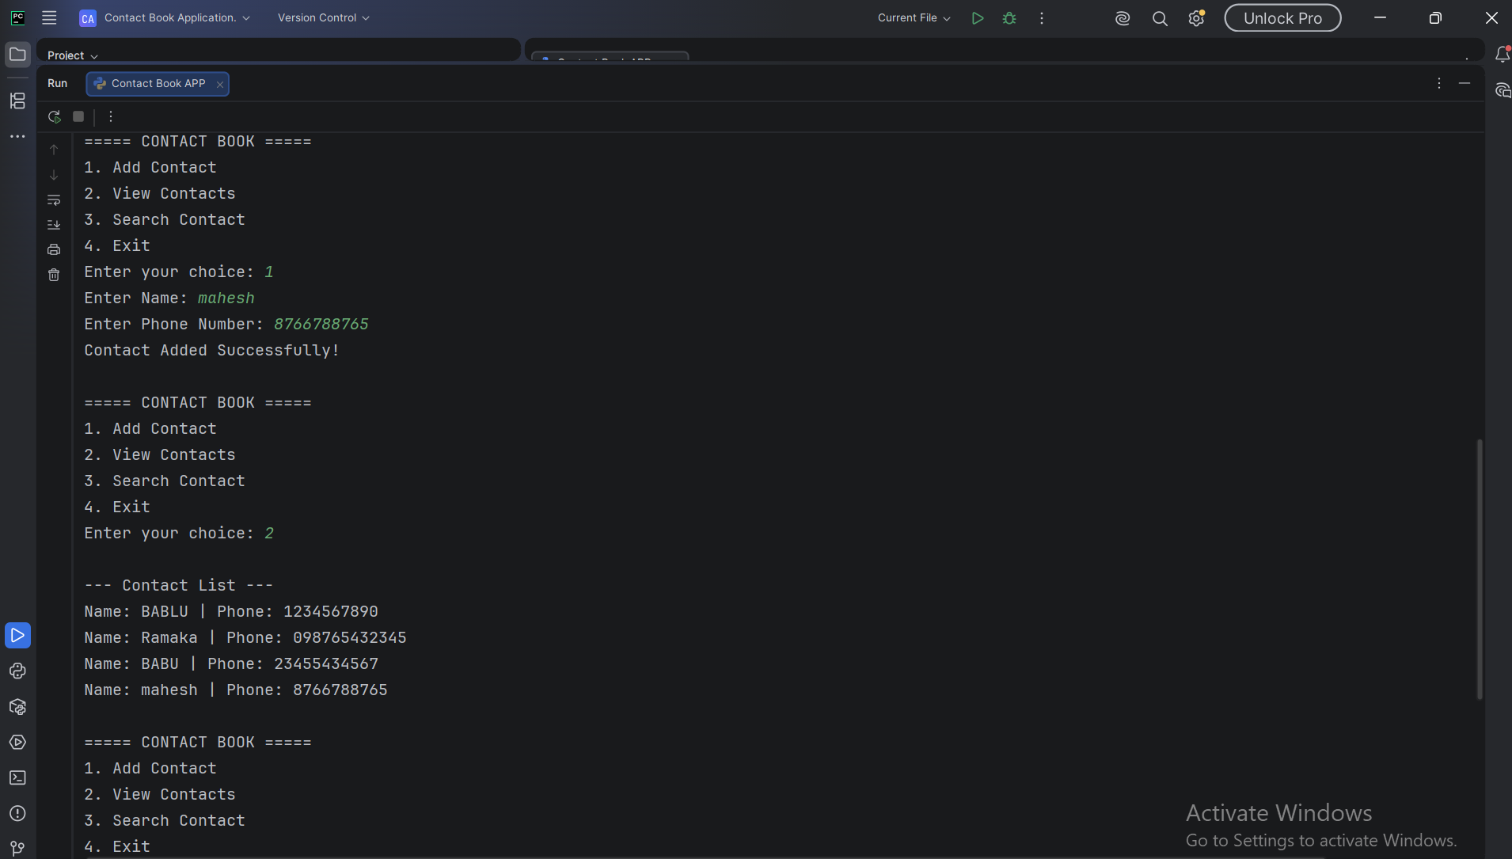
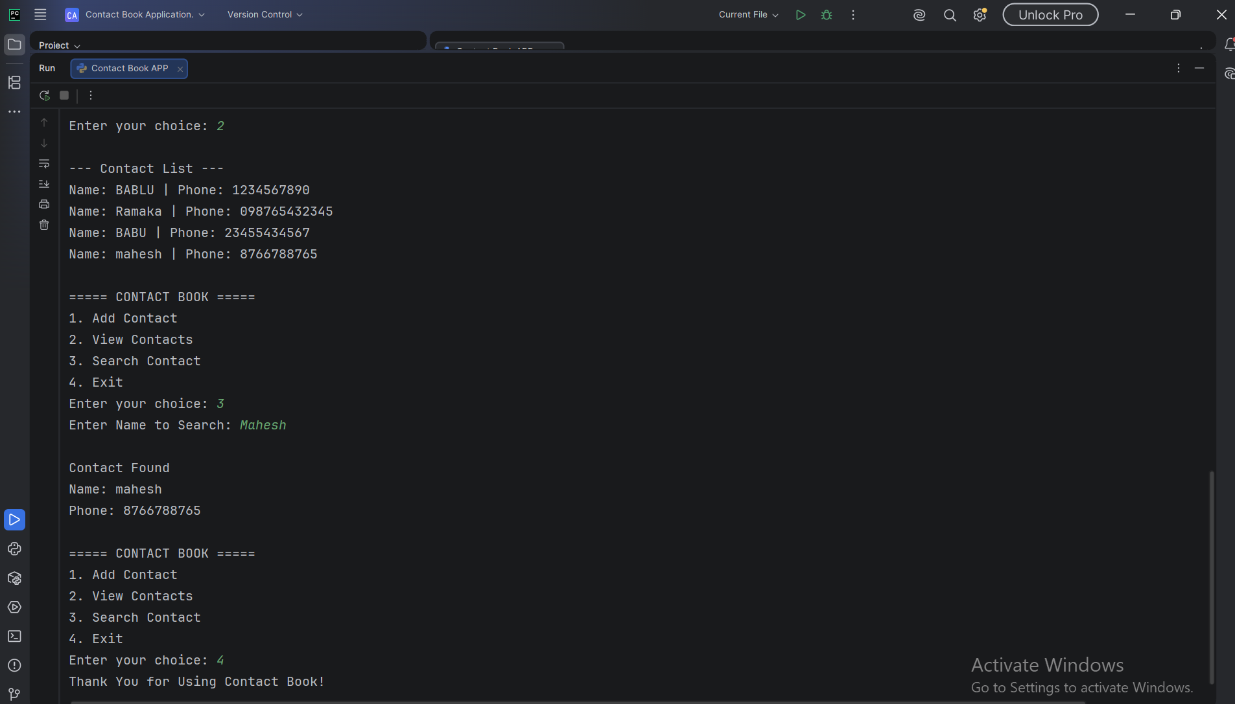
EXECUTION SCREENSHOTS

Slide 13
ADVANTAGES
1. Simple Interface The application provides a clean menu-driven interface with clear options such as Add Contact, View Contacts, and Search Contact. This makes navigation easy and helps users perform tasks without confusion.
2. Easy to Use Users can manage contacts by entering simple keyboard inputs without requiring any technical knowledge. The straightforward design allows anyone to quickly add, view, or search contacts.
3. Permanent Data Storage Contact information is stored in a text file, ensuring that data is not lost when the program is closed. Users can access previously saved contacts whenever they reopen the application.
4. Fast Search Operation The search feature quickly locates a contact by matching the entered name with stored records. This reduces the time required to find specific contact details from the contact list.
5. Beginner Friendly The project uses basic Python concepts such as loops, conditions, file handling, and strings. It is easy for beginners to understand, practice, and enhance with additional features in the future.

Slide 14
CONCLUSION
The Contact Book Application successfully demonstrates the practical implementation of fundamental Python programming concepts such as loops, conditional statements, file handling, functions, and exception handling. Through a simple command-line interface, the application enables users to perform essential contact management operations, including adding new contacts, viewing existing contacts, and searching for specific contact details.
The application provides an efficient and organized way to store contact information while ensuring data persistence through text file storage. Unlike temporary memory-based programs, the saved contact data remains available even after the application is closed and reopened. This makes the system more reliable and useful for everyday contact management tasks.
Overall, the Contact Book Application serves as an excellent beginner-level project that combines multiple Python concepts into a practical real-world solution. It provides a strong foundation for learning software development and can be further enhanced by adding features such as contact editing, deletion, sorting, graphical user interfaces, and database integration in future versions.

Slide 15
THANK YOU

